Slide 1

Team Details
Team Name: AGROPRENEURS
Team Leader Name: Mr DEENADHAYALAN M.
Problem Statement: Tech Solutions Making Regenerative Agriculture Remunerative

Slide 2
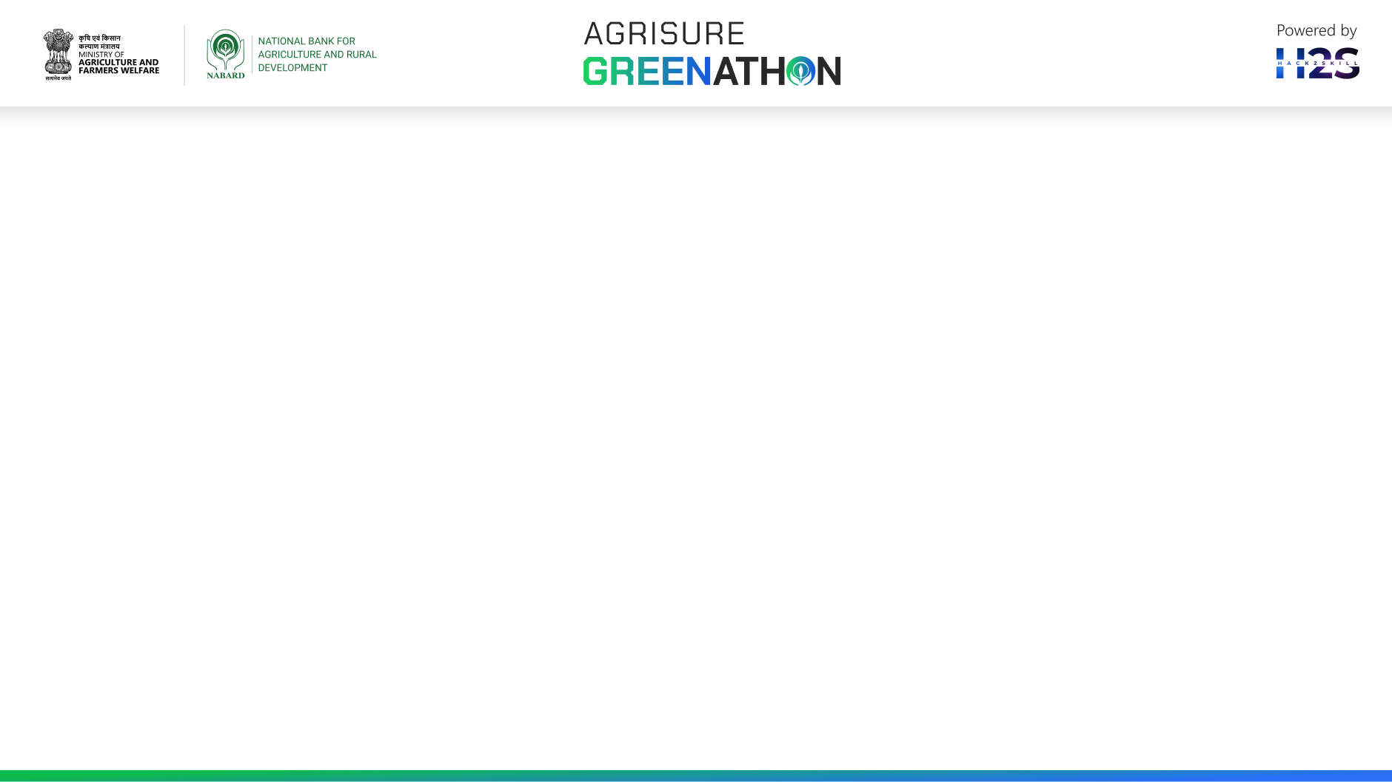
Brief about the idea:
Problem Statement: The important parameters that limit progress in regenerative agriculture are Soil & Water quality and chemical fertilizers used during crop cultivation. Lack of awareness among farmers about the frequent monitoring of depleting quality of soil and water utilized. In addition, chemical fertilizers pose as a major obstacle in sustainability in agriculture.
Solution:
We propose the following,
A Portable Water and Soil Quality Tester
The soil and water quality results (numerical values) are sent to the users’ registered mobile number.
The quality is conveyed to farmers denoting “HIGH”, “OPTIMUM” and “LOW” (Comparison with recommendation from ICAR).
The device, whose quality results are linked with an application that provides Bio-Fertilizers recommendations (available in market) to farmers.
The recommendations are purely based on the results obtained from the real-time soil testing done at the farm.
This reduces cost of fertilizer inputs, thereby boosting the yield that results in higher productivity.
pH
Water Quality parameter
TDS
EC
PARAMETERS ANALYZED
pH
N, P, K
Soil Quality parameter
EC
Temperature

Slide 3
Opportunities:
How different is it from any of the other existing ideas?
This portable soil and water quality tester is the first device that test soil and water quality in agriculture.
No existing automated setup uses Irrigation Water Requirement to irrigate the crops.
No application provides Bio-Fertilizer recommendations to farmers.
How will it be able to solve the problem?
Optimum irrigation water application reduces water demand in agriculture.
Using bio-fertilizer eliminates the inorganic fertilizers usage in the field.
USP of the proposed solution
Only device recommending organic farming among new-age farmers.
Enhances sustainability in agriculture

Slide 4
List of features offered by the solution
Real-time soil and water quality testing
Portable device
Results sent to farmers’ registered mobile number
Soil and water suitability identification
Bio-fertilizer recommendation based on results
Soil quality improving measures

Slide 5
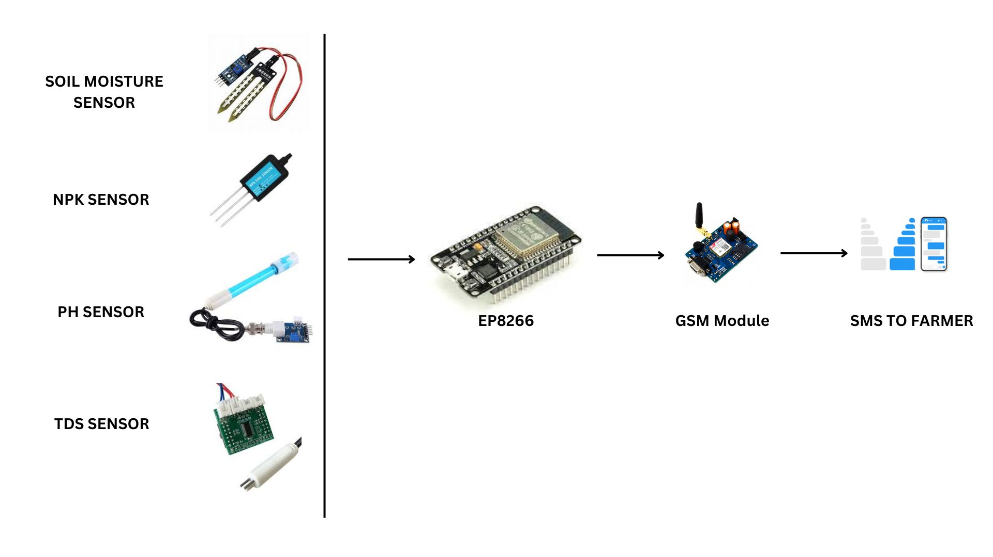
Process flow diagram or Use-case diagram
pH sensor
SMS to farmer
5V DC
TDS sensor
NPK sensor
EP8266
GSM Module
Soil moisture sensor
Ec sensor

Slide 6
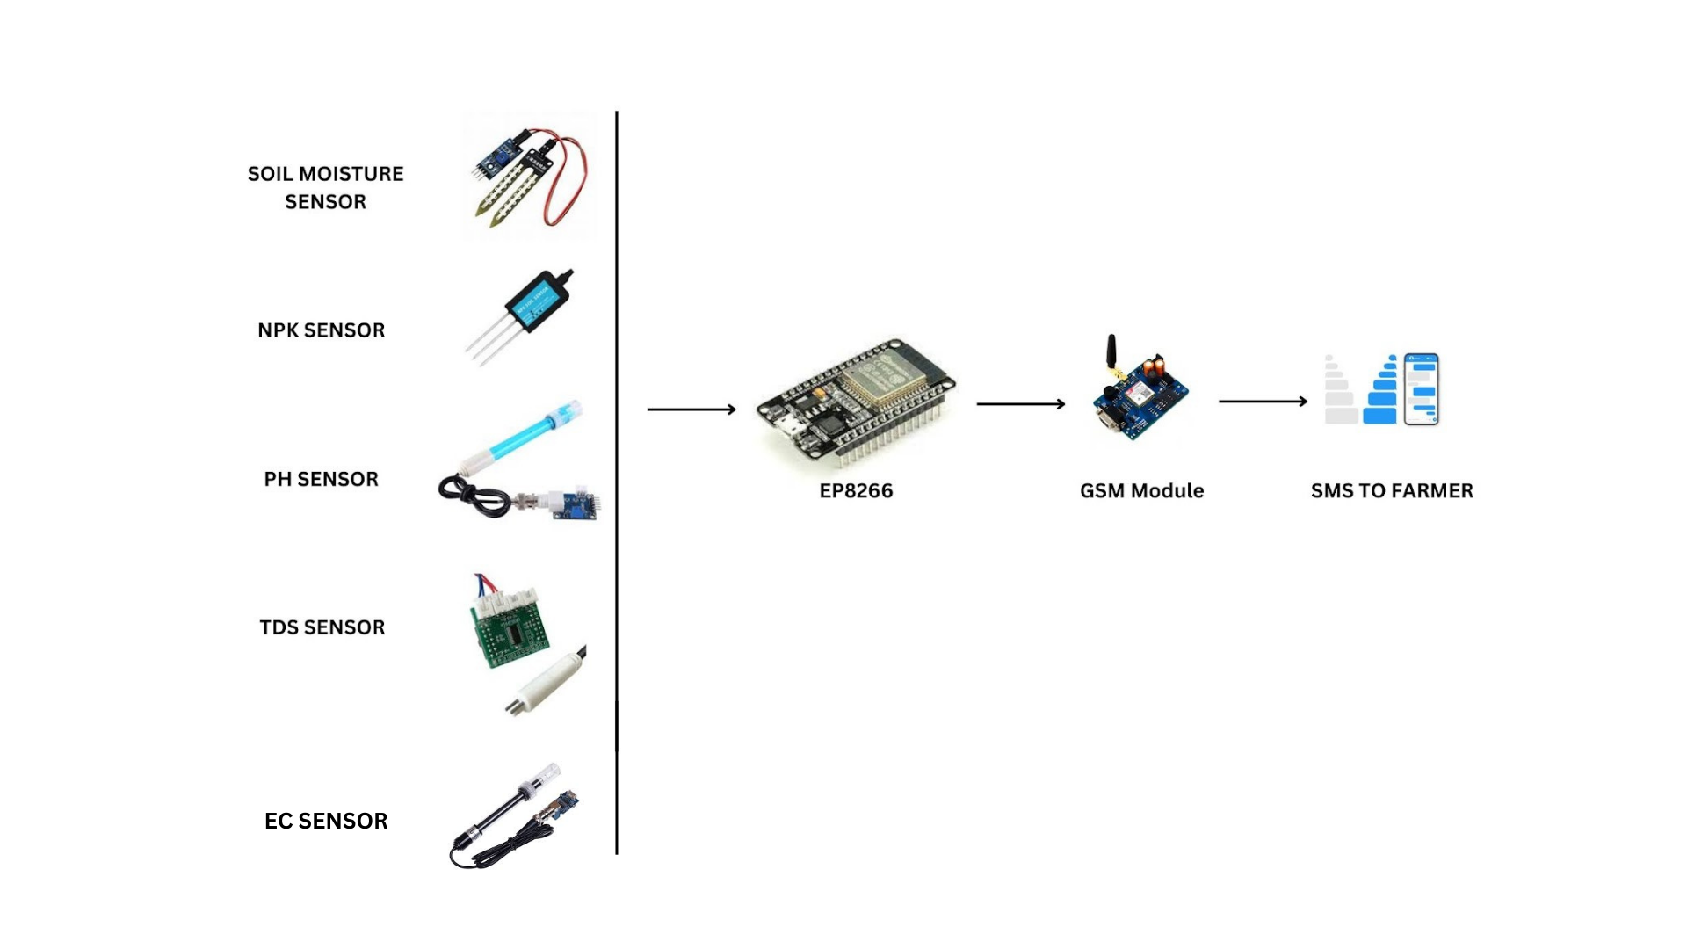
Architecture diagram of the proposed solution

Slide 7
Technologies to be used in the solution
The technologies used in the solution:
ESP8233: The ESP8266 is a similar chip with a built-n 1 MiB flash memory ,allowing the design of single chip devices capable of connect.
GSM module: GSM module is a chip that will be used to establish communication between a mobile device.
TDS sensor: TDS sensor detect the Total dissolved solids level in the soil which can be used to indicate the soil quality.
pH sensor: pH sensor helps to measure the acidity or alkalinity of the soil with a value between 0-14.
WEBSITE :Using of figma to transfer the fertilizer application information to farmers.

Slide 8
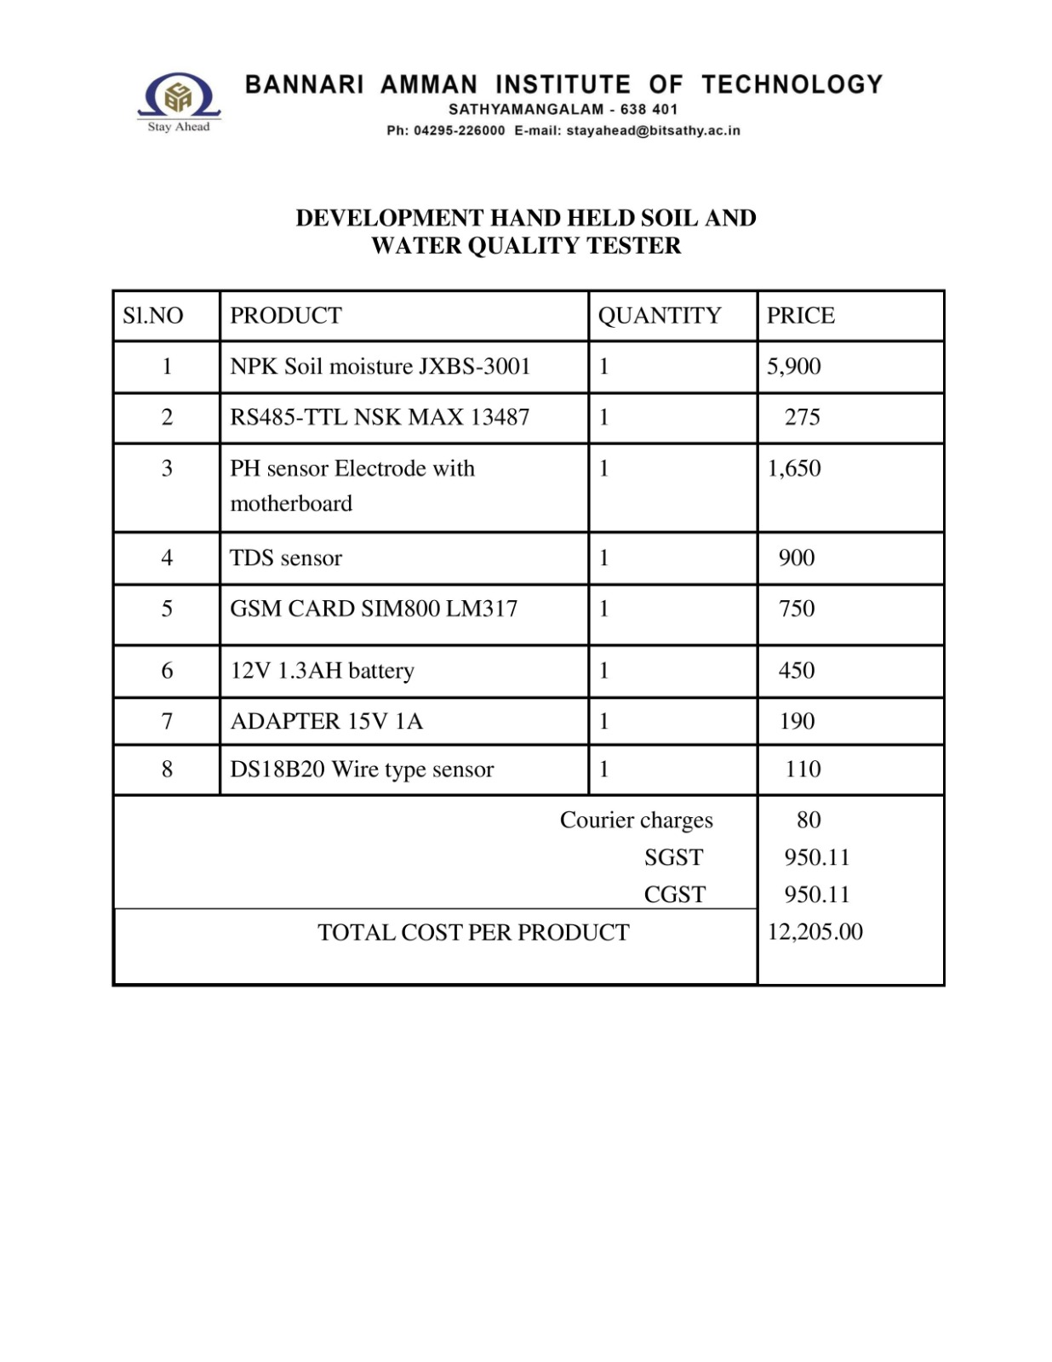
Implementation cost

Slide 9
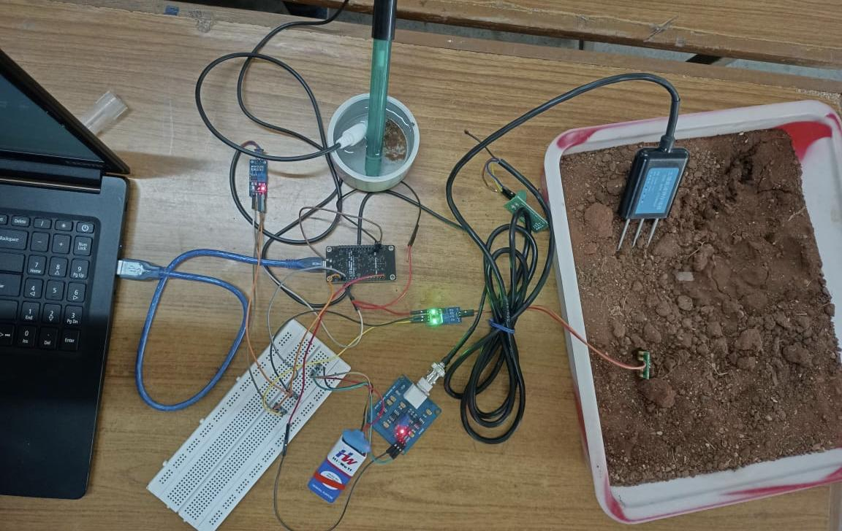
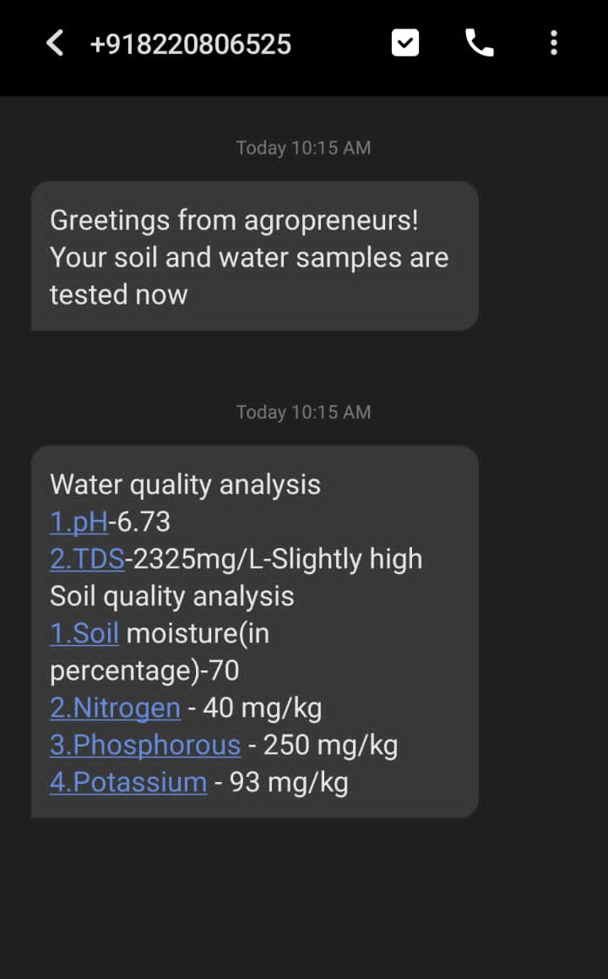
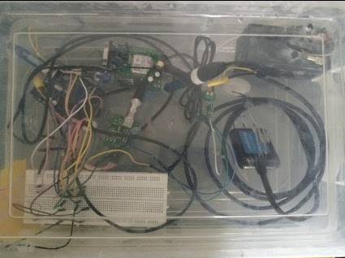
Snapshots of the prototype
TEST RESULTS SENT TO FARMERS’ PHONE
PROTOTYPE

Slide 10
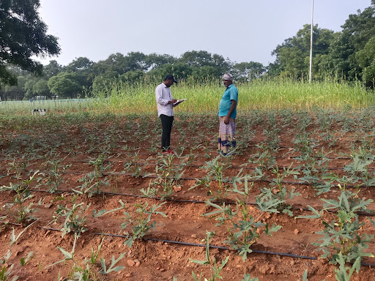
Prototype Performance report/benchmarking
Population set: 46 farmers [Both Male (32) & Female (14)]
Region: Sathyamangalam, Erode, Tamil Nadu
Major crops grown: Sugarcane, Banana, Tomato, Paddy, Jasmine
Testing the Soil and Water Quality tester at the Farmer field
Feature | Rating from users | Suggestion provided
Soil Quality results | 3.74/5 | Addition of Irrigation practices recommendations Suggestions for suitable soil specific crop varieties Suggestions for nearby markets
Water Quality results | 3.61/5
Bio-fertilizer recommendation | 3.72/5
Overall device performance | 3.92/5

Slide 11
Future Developments
Suggestions for Soil specific crop varieties to farmers.
Linking KVK and farmers (Establishing contact)
Addition of upcoming and updated government schemes in agriculture (state-wise)

Slide 12
GitHub Public Repository Link & Demo Video Link
GitHub Public Repository Link:
Demo video: https://drive.google.com/drive/folders/1OUZhVrhCTUhQRNv9hixLOk-vHmyWcfDB?usp=sharing

Slide 13


